Slide 1
CPU Process Dispatcher
& Scheduling Algorithms
CS3521 — Operating Systems Assignment

Slide 2
What This Presentation Covers
File structure
Context switching
1
5
How the 6 source files connect and depend on each other
How a pointer swap implements context switching
process.h — PCB
4 algorithms
2
6
Every field in the Process Control Block and its role
FCFS, Round Robin, SJF, Priority — differences explained
Queue (queue.c)
Statistics
3
7
Singly linked list: enqueue, dequeue, O(1) operations
How waiting time and turnaround time are tracked and printed
Dispatcher loop
4
The 5-step per-tick cycle that drives the whole simulation

Slide 3
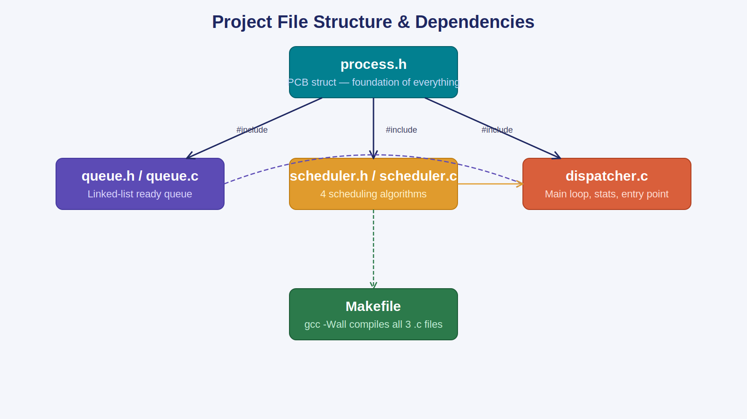
File Structure & Dependencies
process.h is the foundation — every other file includes it. The Makefile compiles all three .c files in one command.

Slide 4
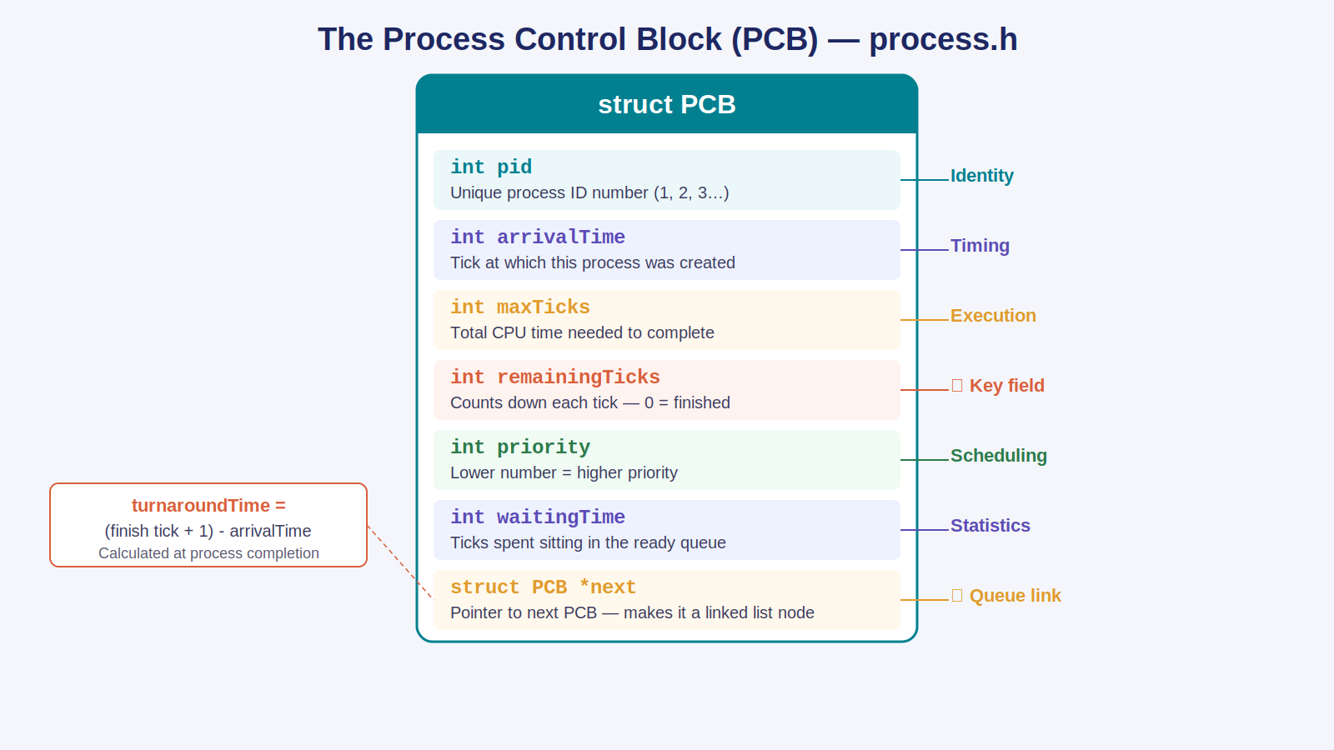
The Process Control Block — process.h
Every process is represented by one PCB on the heap. remainingTicks counts down to zero; *next links it into the queue.

Slide 5
process.h — Full Source
#ifndef PROCESS_H #define PROCESS_H typedef struct PCB { int pid; // unique process ID int arrivalTime; // tick when created int maxTicks; // total CPU time needed int remainingTicks; // counts down — 0 = done ★ int priority; // lower = higher priority int waitingTime; // ticks spent in queue int turnaroundTime; // set when process finishes struct PCB *next; // linked list pointer ★ } PCB; #endif

Slide 6
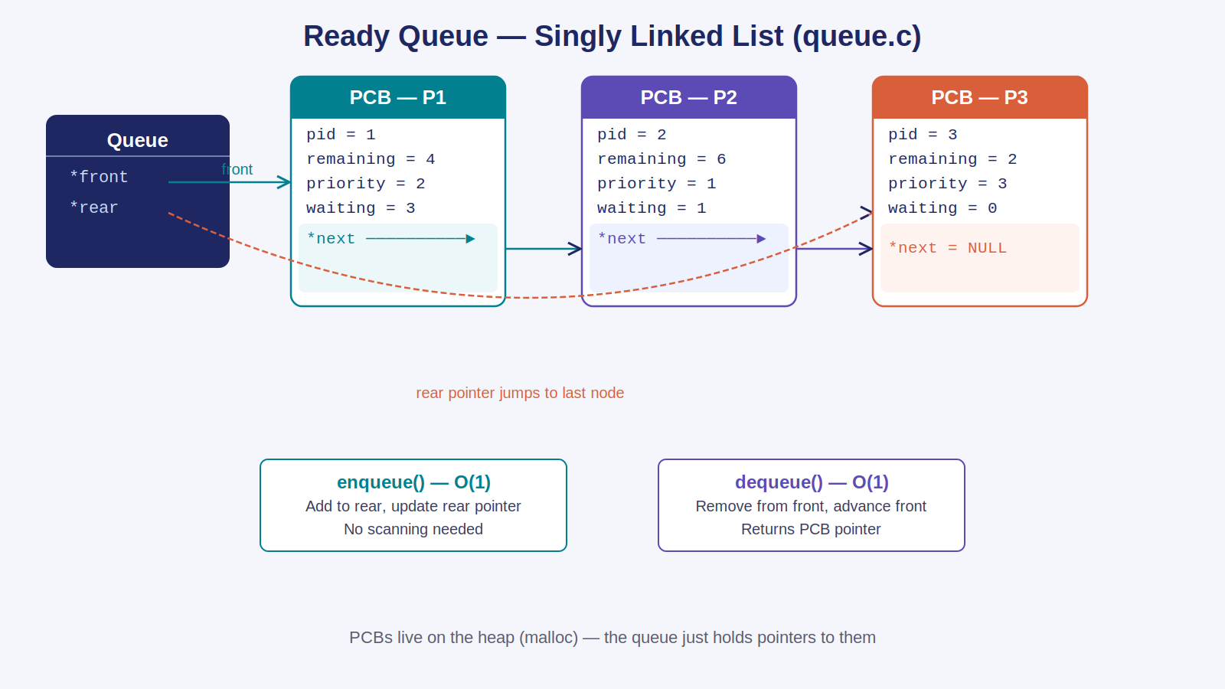
Ready Queue — Singly Linked List (queue.c)
front pointer enables O(1) dequeue. rear pointer enables O(1) enqueue. No array scanning ever needed.

Slide 7
queue.c — Key Operations
enqueue()
dequeue()
void enqueue(Queue *q, PCB *p) { p->next = NULL; if (q->rear == NULL) { q->front = q->rear = p; return; } q->rear->next = p; q->rear = p; }
PCB* dequeue(Queue *q) { if (q->front == NULL) return NULL; PCB *temp = q->front; q->front = q->front->next; if (q->front == NULL) q->rear = NULL; return temp; }

Slide 8
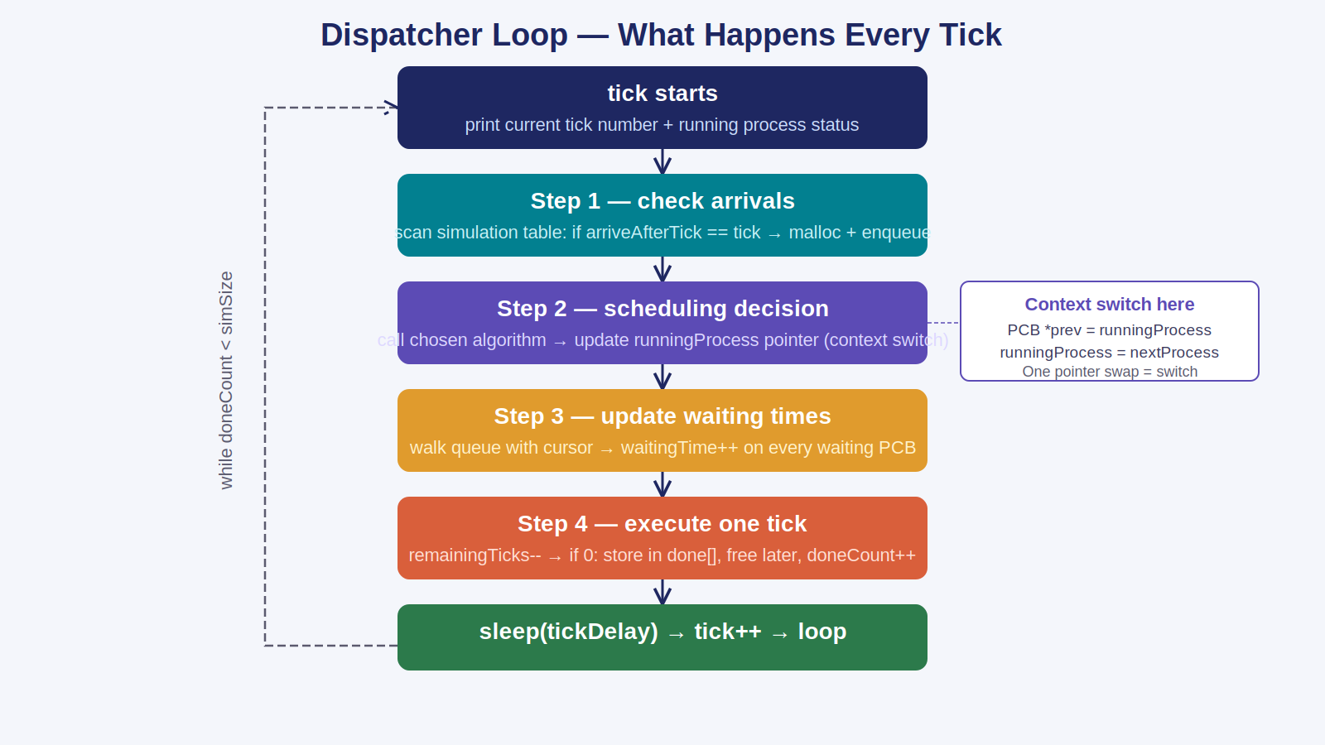
Dispatcher Loop — dispatcher.c
Five ordered steps execute every tick. The loop runs until doneCount == simSize (all processes finished).

Slide 9
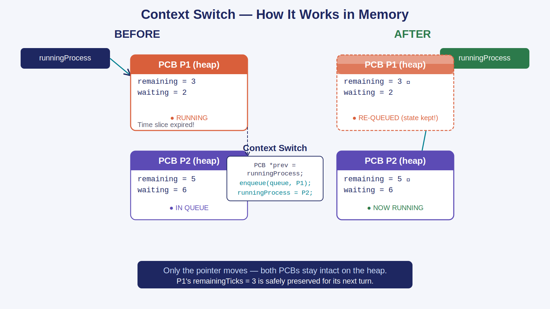
Context Switch — How It Really Works
A single pointer reassignment: runningProcess = nextProcess. The preempted PCB is re-queued with its remainingTicks preserved.

Slide 10
Context Switch — The Code
/* Step 2 of each tick — scheduling decision + context switch */ PCB *prev = runningProcess; // remember who was running if (choice == ALG_RR) { runningProcess = RoundRobin(readyQueue, runningProcess, TIME_SLICE, &rrCounter); /* RoundRobin re-queues the old process if slice expired: enqueue(readyQueue, runningProcess); ← saves state return dequeue(readyQueue); ← picks next */ } else if (choice == ALG_FCFS) { if (runningProcess == NULL) // non-preemptive: only switch when idle runningProcess = FCFS(readyQueue); } if (runningProcess != prev && runningProcess != NULL) printf(" -> Context switch: P%d dispatched\n", runningProcess->pid);

Slide 11
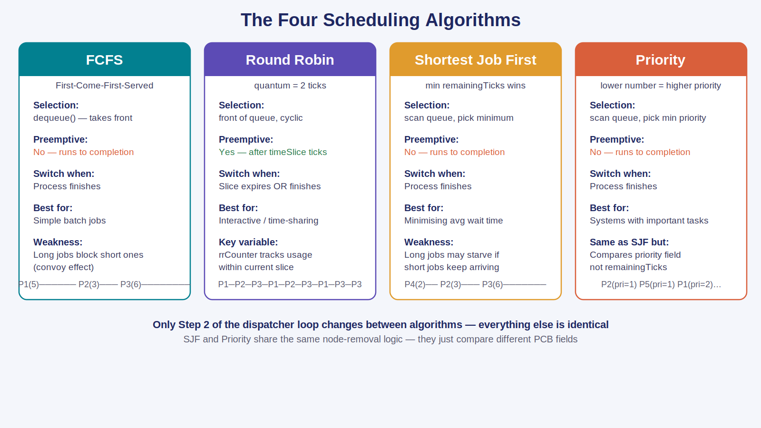
The Four Scheduling Algorithms — Compared
FCFS and RR use dequeue() directly. SJF and Priority scan the entire queue to extract the best candidate.

Slide 12
Round Robin — scheduler.c (the only preemptive algorithm)
PCB* RoundRobin(Queue *q, PCB *running, int timeSlice, int *counter) { if (running != NULL) { (*counter)++; // tick used this slice if (*counter >= timeSlice) { // slice expired → preempt! *counter = 0; enqueue(q, running); // re-queue with state preserved return dequeue(q); // pick next in line } return running; // still within slice } *counter = 0; // fresh start return dequeue(q); // CPU was idle }

Slide 13
SJF & Priority — Queue Scanning + Node Removal
PCB* ShortestJobFirst(Queue *q) { if (isEmpty(q)) return NULL; /* Pass 1: find the node with fewest remaining ticks */ PCB *shortest = q->front, *cur = q->front->next; while (cur) { if (cur->remainingTicks < shortest->remainingTicks) shortest = cur; cur = cur->next; } /* Pass 2: re-link queue around the chosen node */ PCB *prev = NULL; cur = q->front; while (cur != shortest) { prev = cur; cur = cur->next; } if (prev) prev->next = shortest->next; else q->front = shortest->next; // was at front if (q->rear == shortest) q->rear = prev; shortest->next = NULL;
return shortest;
}

Slide 14
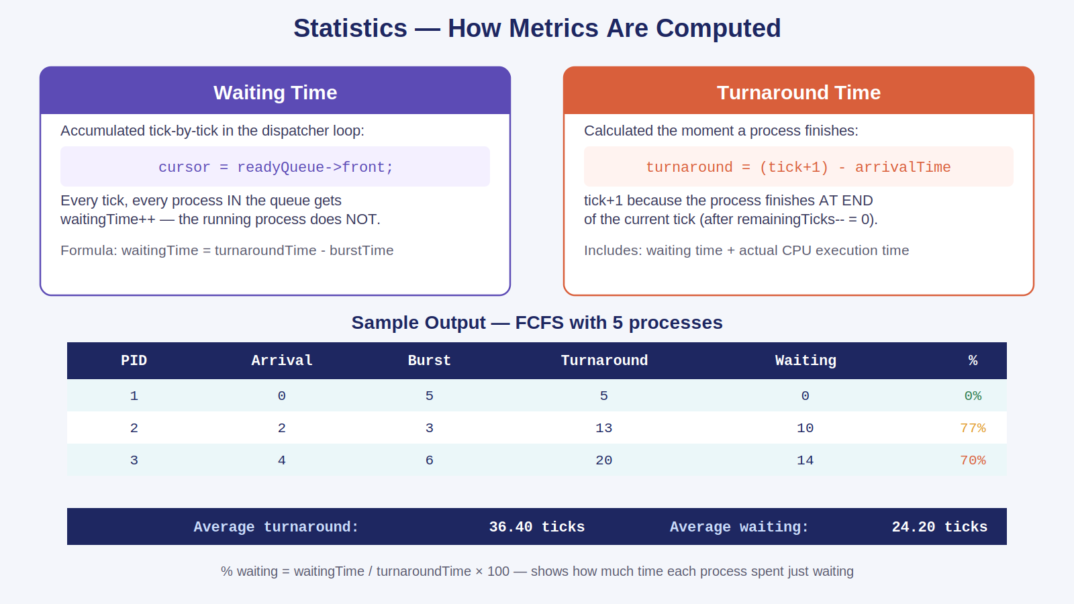
Statistics — Waiting Time & Turnaround Time
Metrics accumulate live during the simulation. printStats() outputs a formatted table with per-process and average values.

Slide 15
Summary
process.h
PCB struct with 8 fields — the identity card of every process
queue.c
Singly linked list — O(1) enqueue at rear, O(1) dequeue at front
scheduler.c
4 algorithms — only Step 2 of the dispatcher loop changes
dispatcher.c
5-step per-tick loop — arrivals → decision → wait → execute → sleep
Context switch
One pointer swap: runningProcess = nextProcess; state stays in PCB

